Slide 1

Python for ML
content prepared from the book Intro to Python for Computer Science and Data Science Paul Deitel; Harvey M. Deitel and other Internet resources

Slide 2
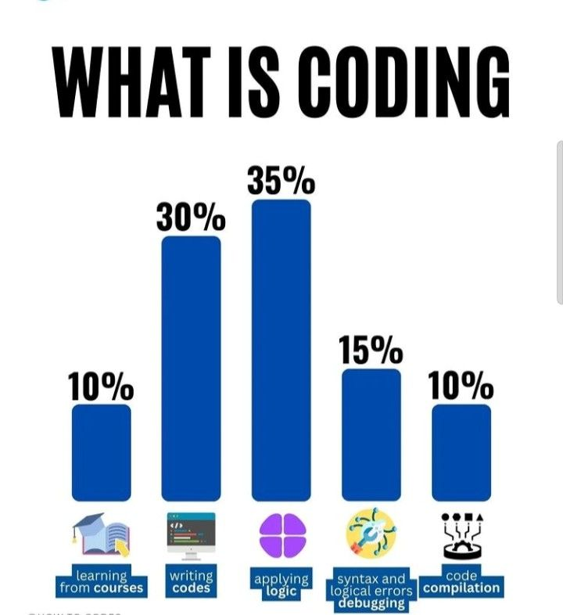

Slide 3
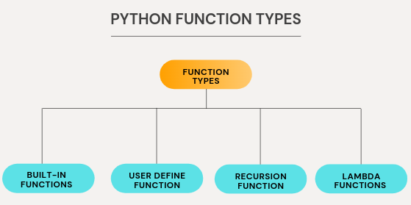
Functions
Experience has shown that the best way to develop and maintain a large program is to construct it from smaller, more manageable pieces.
This technique is called divide and conquer. Using existing functions as building blocks for creating new programs is a key aspect of software reusability —it’s also a major benefit of object-oriented programming.
Packaging code as a function allows you to execute it from various locations in your program just by calling the function, rather than duplicating the possibly lengthy code.
This also makes programs easier to modify.
When you change a function’s code, all calls to the function execute the updated version.

Slide 4
Python Standard Library modules
collections -Data structures beyond lists, ruples, dictionaries and sets.
Cryptography modules--Encrypting data for secure transmission.
csv--Processing comma-separated value files (like those in Excel).
datetime- Date and time manipulations. Also modules time and calendar.
decimal-Fixed-point and floating-point arithmetic, including monetary calculations.
doctest_-Embed validation tests and expected results in docstrings for simple unit testing.
gettext and locale- Internationalization and localization modules.

Slide 5
json-JavaScript Object Notation (SON) processing used with web services and NoSQL document databases
os--Interacting with the operating system. profile, pstats,
timeit--Performance analysis.random-_-Pseudorandom numbers.
re-Regular expressions for pattern matching.
sqlite3-SQLite relational database access.
statistics--Mathematical statistics functions such as mean, median, mode and variance.
string-String processing.
sys-Command-line argument processing;standard input, standard output and standarderror streams.
tkinter-_-Graphical user interfaces (GUIs) and canvas-based graphics.
turtle--Turtle graphics.webbrowser-For conveniently displaying web pages in Python apps.
Python Standard Library modules

Slide 6
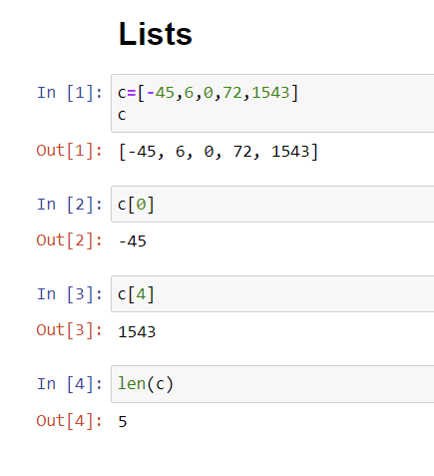
Lists
Lists typically store homogeneous data, that is, values of the same data type.
Consider the list c, which contains five integer elements:
They also may store heterogeneous data, that is, data of many different types.
For example, the following list contains a student's first name (a string), last name (a string), grade point average (a float) and graduation year (an int):
['Mary', "Smith', 3.57, 2022]

Slide 7
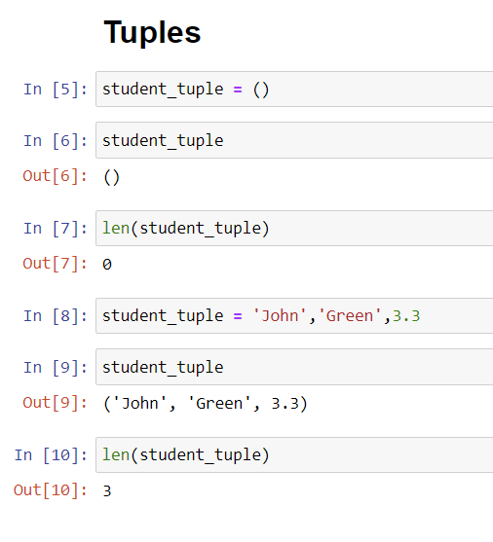
Tuples
Tuples are immutable and typically store heterogeneous data, but the data can be homogeneous.
A tuple’s length is its number of elements and cannot change during program execution.

Slide 8
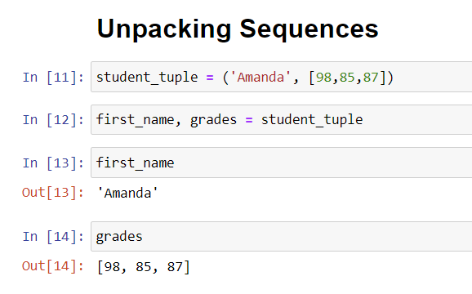
Unpacking sequences
You can unpack any sequence’s elements by assigning the sequence to a comma-separated list of variables.
A ValueError occurs if the number of variables to the left of the assignment symbol is not identical to the number of elements in the sequence on the right:

Slide 9
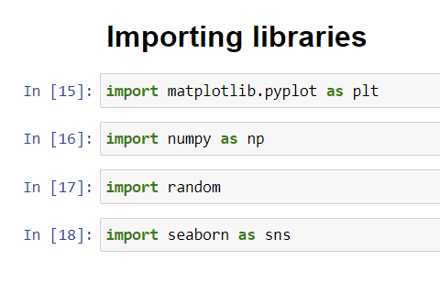
Python for Data Science
The matplotlib pyplot module contains the Matplotlib library’s graphing capabilities. This module is typically imported with the name plt.
The NumPy (Numerical Python) library includes the function unique that we’ll use to summarise the die rolls. The NumPy module typically is imported as np.
The random module contains Python’s random-number generation functions.
The seaborn module contains the Seaborn library’s graphing capabilities we use. This module is typically imported with the name sns.

Slide 10
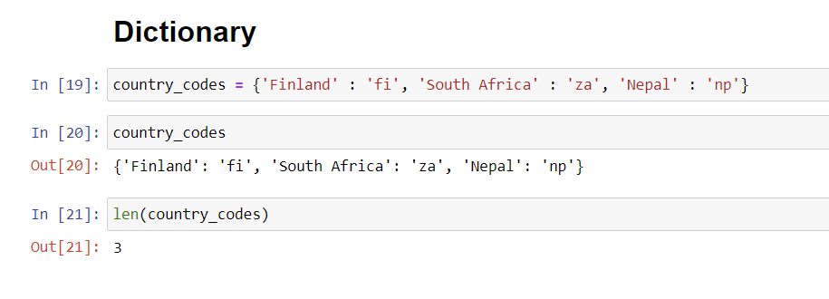
Dictionaries
A dictionary associates keys with values. Each key maps to a specific value.
The following table contains examples of dictionaries with their keys, key types, values and value types:

Slide 11
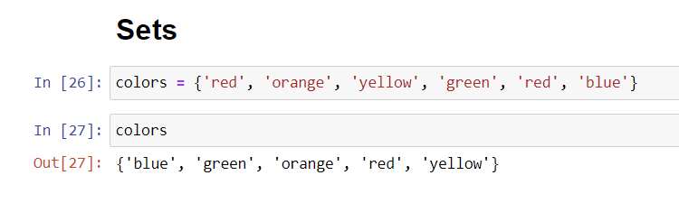
Sets
A set is an unordered collection of unique values. Sets may contain only immutable objects, like strings, ints, floats and tuples that contain only immutable elements.
Though sets are iterable, they are not sequences and do not support indexing and slicing with square brackets, [].
Dictionaries also do not support slicing

Slide 12
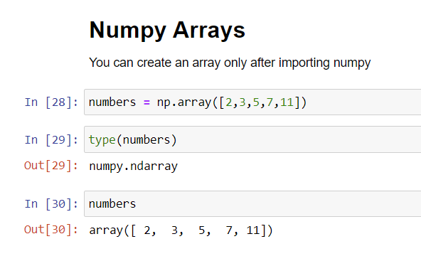
Numpy
The NumPy (Numerical Python) library first appeared in 2006 and is the preferred Python array implementation.
It offers a high-performance, richly functional n-dimensional array type called ndarray, which from this point forward we’ll refer to by its synonym, array.
NumPy is one of the many opensource libraries that the Anaconda Python distribution installs.
Operations on arrays are up to two orders of magnitude faster than those on lists. In a big-data world in which applications may do massive amounts of processing on vast amounts of array-based data, this performance advantage can be critical.
According to libraries.io, over 450 Python libraries depend on NumPy. Many popular data science libraries such as Pandas, SciPy (Scientific Python) and Keras (for deep learning) are built on or depend on NumPy.

Slide 13
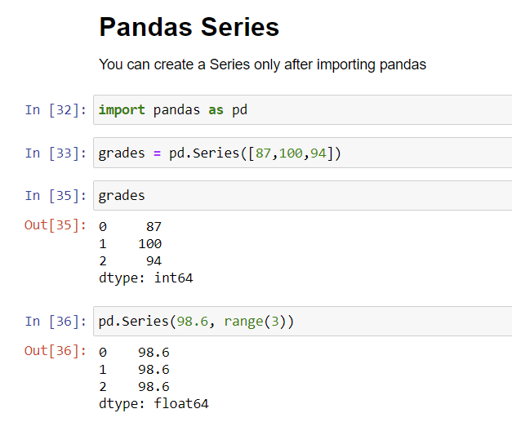
Pandas for Data Science
A Series is an enhanced one-dimensional array.
Whereas arrays use only zero-based integer indices, Series support custom indexing, including even non-integer indices like strings.
Series also offer additional capabilities that make them more convenient for many data-science-oriented tasks.
For example, Series may have missing data, and many Series operations ignore missing data by default.

Slide 14
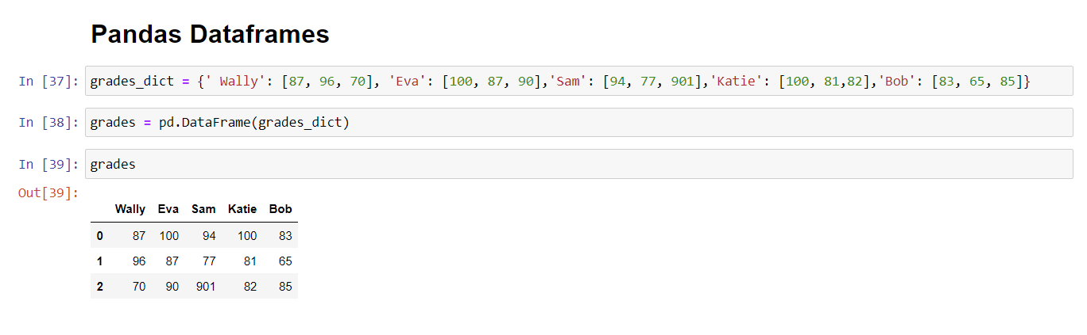
Dataframes
A DataFrame is an enhanced two-dimensional array.
Like Series, DataFrames can have custom row and column indices, and offer additional operations and capabilities that make them more convenient for many data-science-oriented tasks.
DataFrames also support missing data.
Each column in a DataFrame is a Series.
The Series representing each column may contain different element types, as you’ll soon see when we discuss loading datasets into DataFrames.

Slide 15
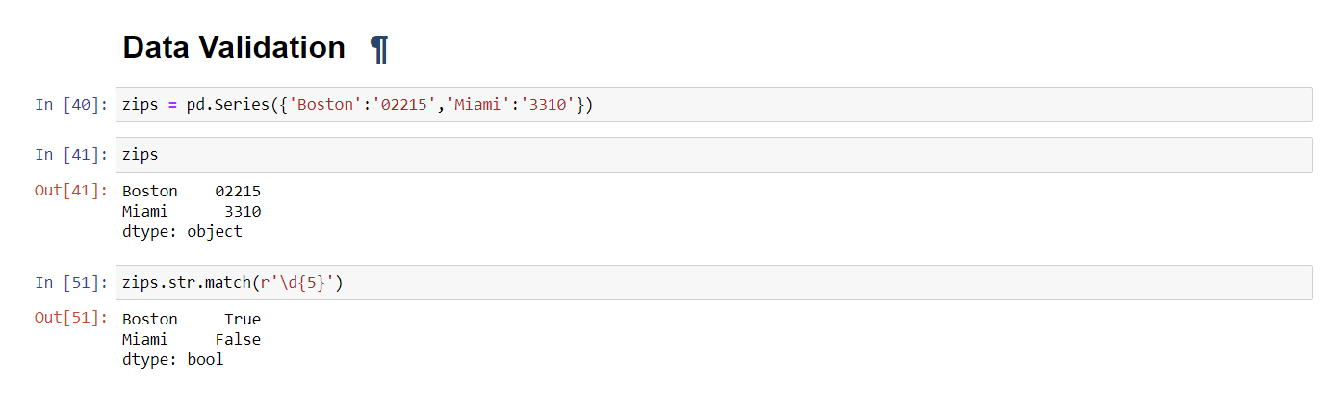
Data Wrangling
Let’s begin by creating a Series of five-digit ZIP Codes from a dictionary of city-name/five-digit-ZIP-Code key–value pairs.
We intentionally entered an invalid ZIP Code for Miami:

Slide 16
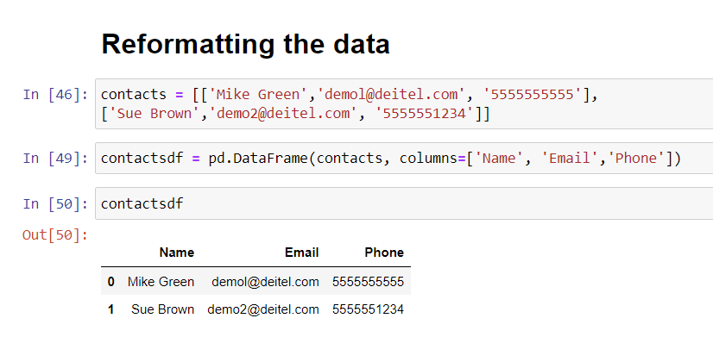
Data munging
We’ve discussed data cleaning. Now let’s consider munging
data into a different format. As a simple example, assume that
an application requires U.S. phone numbers in the format
###-###-####, with hyphens separating each group of
digits. The phone numbers have been provided to us as 10-
digit strings without hyphens. Let’s create the DataFrame:

Slide 17
Serialization with JSON
Many libraries we’ll use to interact with cloud-based services such as Twitter, IBM Watson and others communicate with your applications via JSON objects.
JSON (JavaScript Object Notation) is a text-based, human-and-computer-readable, datainterchange format used to represent objects (such as dictionaries, lists and more) as collections of name–value pairs.

Slide 18
Values in JSON objects and arrays can be:
strings in double quotes (like "Jones"),
numbers (like 100 or 24.98),
JSON Boolean values (represented as true or false in JSON),
null (to represent no value, like None in Python),
arrays (like [100, 200, 300]), and
other JSON objects.

Slide 19
Let’s write that object in JSON format to a file:
In [2]: import json
In [3]: with open('accounts.json', 'w') as
accounts:
...: json.dump(accounts_dict, accounts)
Snippet [3] opens the file accounts.json and uses the json module’s dump function to serialize the dictionary accounts_dict into the file. The resulting file contains the following text, which we reformatted slightly for readability:
{"accounts":
[{"account": 100, "name": "Jones", "balance":
24.98},
{"account": 200, "name": "Doe", "balance":
345.67}]}

Slide 20
Working with CSV files
You can load a CSV dataset into a DataFrame with the pandas function read_csv.
The following loads and displays the CSV file accounts.csv that you created earlier in this chapter:
In [1]: import pandas as pd
In [2]: df = pd.read_csv('accounts.csv',
...: names=['account',
'name', 'balance'])
...:
In [3]: df

Slide 21

End module questions

Slide 22

Question 1
Create an array containing the values 1–15, reshape it into a 3-by-5 array, then use indexing and slicing techniques to perform each of the following operations:
1. Select row 2.
2. Select column 5.
3. Select rows 0 and 1.
4. Select columns 2–4.
5. Select the element that is in row 1 and column 4.
6. Select all elements from rows 1 and 2 that are in columns 0, 2 and 4.

Slide 23
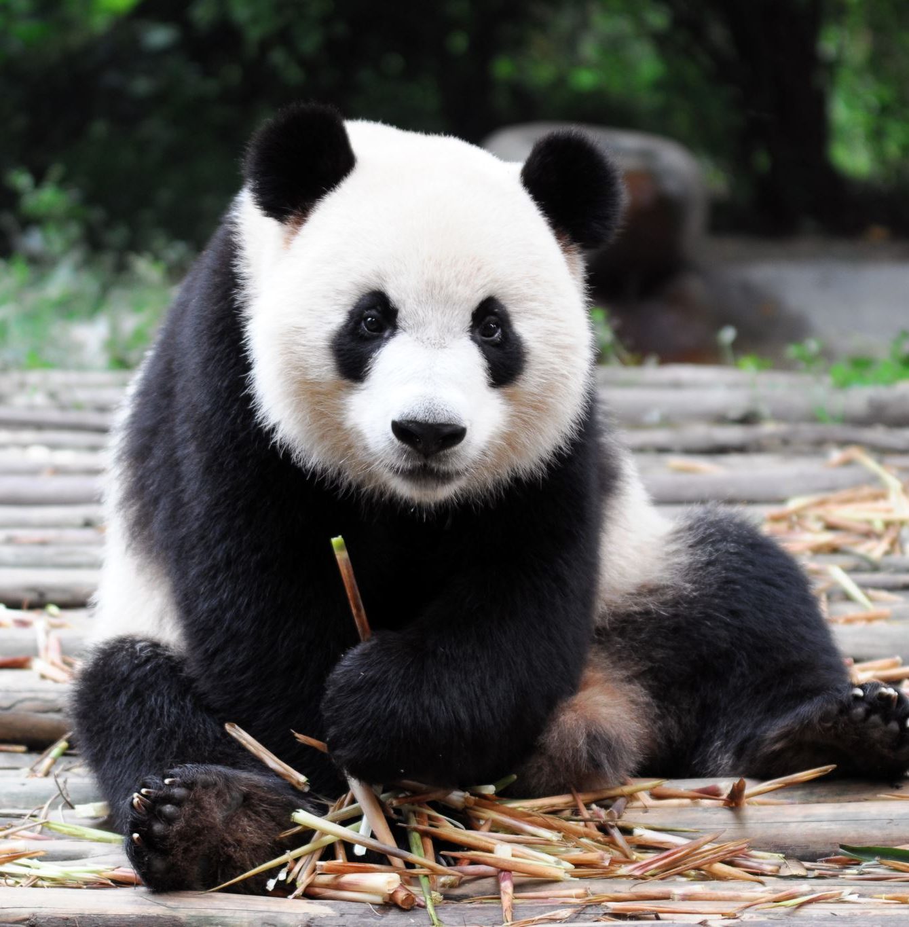
Question 2
Perform the following tasks with pandas DataFrames:
1. Create a DataFrame named temperatures from a dictionary of three temperature readings each for 'Maxine’, 'James' and 'Amanda'.
2. Recreate the DataFrame temperatures in Part (a) with custom indices using the index keyword argument and a list containing 'Morning', 'Afternoon' and 'Evening'.
3. Select from temperatures the column of temperature readings for 'Maxine'.
4. Select from temperatures the row of 'Morning’ temperature readings.
5. Select from temperatures the rows for 'Morning' and 'Evening' temperature readings.
6. Select from temperatures the columns of temperature readings for 'Amanda' and 'Maxine'.
7. Select from temperatures the elements for 'Amanda' and 'Maxine' in the 'Morning' and 'Afternoon'.
8. Use the describe method to produce temperatures’ descriptive statistics.
9. Transpose temperatures.
10. Sort temperatures so that its column names are in alphabetical order

Slide 24
Question 3
Class Average: Writing Grades to a Plain Text File
In an Ipython session, write code that enables you to store any number of grades into a grades.txt plain text file.
Class Average: Reading Grades from a Plain Text File
In an Ipython session, write code that reads the grades from the grades.txt file you created in the previous exercise. Display the individual grades and their total, count and average.
Class Average: Writing Student Records to a CSV File
An instructor teaches a class in which each student takes three exams. The instructor would like to store this information in a file named grades.csv for later use. Write code that enables an instructor to enter each student’s first name and last name as strings and the student’s three exam grades as integers. Use the csv module to write each record into the grades.csv file. Each record should be a single line of text in the following CSV format:
firstname,lastname,exam1grade,exam2grade,exam3grade
Class Average: Reading Student Records from a CSV File
Use the csv module to read the grades.csv file from the previous exercise. Display the data in tabular format.
Class Average: Creating a Grade Report from a CSV File
Modify your solution to the preceding exercise to create a grade report that displays each student’s average to the right of that student’s row and the class average for each exam below that exam’s column.

